Slide 1
Chapter 5
How to use
the CSS box model
Notes:
Is where the browser places each block element, so it is easier to control the spacing, borders, and other formatting. This is the CSS box model

Slide 2
Objectives
Applied
Given an HTML document, create CSS style rules that use the CSS box model to apply spacing, borders, and backgrounds to the web page.

Slide 3
Objectives (cont.)
Knowledge
Describe the use of the CSS box model.
Explain how the CSS box model can be used to control the spacing between the headings and paragraphs on a page.
Describe these properties for formatting block elements: height, margin, and padding.
Describe the effect of “collapsed margins.”
Describe the use of a reset selector.
Describe the use of these properties for formatting block elements: border, border-color, and background-color.
Describe these CSS features for formatting block elements: rounded corners, shadows, background gradients.

Slide 4
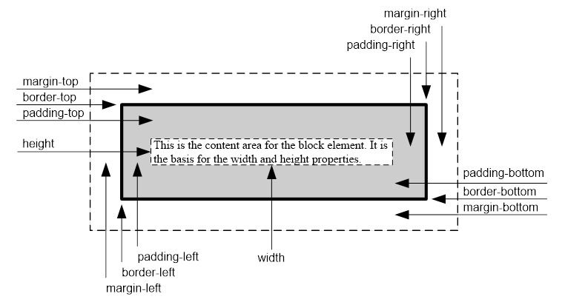
The CSS box model
Notes:
The CSS box model lets you work with these boxes around each element
Margin – the spacing of the border of an element and either its containing block or the element next to it
Padding – spacing between an element and its border
Height and width can be used to define the size of the content area for the element
Other properties can be used to control margins padding and borders for a block element, and that is added to the height and width of the content area to determine the overall size of the box

Slide 5
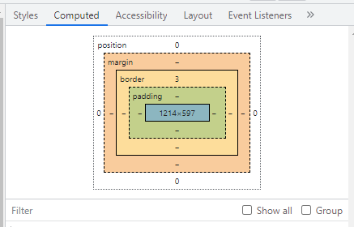
Developer Tools view
Notes:
Developer tools also has a visual of the selected element CSS box model

Slide 6
The formula for calculating the height of a box
top margin +
top border +
top padding +
height +
bottom padding +
bottom border +
bottom margin
= box height
The formula for calculating the width of a box
left margin +
left border +
left padding +
width +
right padding +
right border +
right margin
= box width

Slide 7
The HTML for a page that uses the box model
<body>
<main>
<h1>San Joaquin Valley Town Hall</h1>
<p>Welcome to San Joaquin Valley Town Hall.
We have some fascinating speakers for you this
season!</p>
</main>
</body>
Notes:
To understand the box model, here we have the HTML for the page.

Slide 8
The CSS for the page that uses the box model
body {
border: 3px dotted black;
margin: 10px; /* 4 sides */
}
main {
border: 2px solid black;
width: 500px; /* fixed width */
margin: 20px; /* 4 sides */
padding: 10px; /* 4 sides */
}
h1, p {
border: 1px dashed black;
padding: 10px; /* 4 sides */
}
h1 {
margin: .5em 0 .25em; /* top | right/left | bottom */
padding-left: 15px; /* 1 side */
}
p {
margin: 0; /* 4 sides */
padding-left: 15px; /* 1 side */
}
Notes:
Here we have the CSS; As we review it we can see it adds borders to all the block elements on the page. The borders are of different styles and sizes. We also have padding and margins

Slide 9
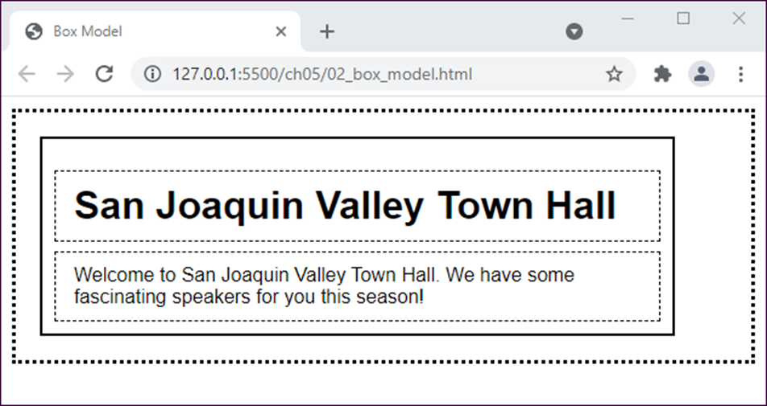
The web page in a browser
Notes:
the borders are clearly defined, outlining the box elements.

Slide 10
Width and height properties
Property | Description
width | The width of the content area for a block element
height | The height of the content area for a block element
min-width | The minimum width of the content area for a block element
max-width | The maximum width of the content area for a block element
min-height | The minimum height of the content area for a block element
max-height | The maximum height of the content area for a block element
Notes:
Width/height auto is default

Slide 11
How to set the width of the content area
width: 450px; /* an absolute width */
width: 75%; /* a relative width */
width: auto; /* width based on its containing
block (the default) */
How to set the height of the content area
height: 125px;
height: 50%;
height: auto; /* height based on its content (default) */
How to set the minimum and maximum width and height
min-width: 450px;
max-width: 600px;
min-height: 120px;
max-height: 160px;
Notes:
Sizing and spacing elements. We have reviewed several different properties to define the size spacing of an element. Here we will begin digging into these properties more.
Width and height can be set to relative or absolute values
Min values will always be at least that size, even if there is not enough content to fill it.
Max values are a hard stop; if the content exceeds the sized element it will either be hidden or scrollbars appear to view the additional content

Slide 12
How to set the margin on a single side
margin-top: .5em;
margin-left: 1em;
How to set the margins on multiple sides
margin: 1em; /* all four sides */
margin: 0 1em; /* top and bottom, right and left */
margin: .5em 1em 2em; /* top, right and left, bottom */
margin: .5em 1em 2em 1em; /* top, right, bottom, left */
Notes:
When you specify the margin-bottom for an element and margin-top for the following element, the margin is collapsed, and only the larger of the two is applied

Slide 13
How to set the padding on a single side of an element
padding-top: 0;
padding-right: 1em;
How to set the padding on multiple sides of an element
padding: 1em; /* all four sides */
padding: 0 1em; /* top and bottom, right and left */
padding: 0 1em .5em; /* top, right and left, bottom */
padding: 0 1em .5em 1em; /* top, right, bottom, left */

Slide 14

A web page with widths, margins, and padding
Notes:
On the same page from the last chapter, we can see the layout is much cleaner. The content is Centered within the page and all the element spacing has been greatly improved.

Slide 15
The HTML for the page (part 1)
<header>
<img src="images/logo.gif" alt="Town Hall Logo"
width="80">
<h2>San Joaquin Valley Town Hall</h2>
<h3>Bringing cutting-edge speakers to the valley</h3>
</header>

Slide 16
The HTML for the page (part 2)
<main>
<h1>This season's guest speakers</h1>
<nav>
<ul>
<li>October: <a class="date_passed"
href="speakers/brancaccio.html">
David Brancaccio</a></li>
...
<li>April: <a href="speakers/tynan.html">
Ronan Tynan</a></li>
</ul>
</nav>
<h2>Looking for a unique gift?</h2>
<p>Town Hall has the answer. For only $100, ....</p>
<p>Or, for $50, you can give yourself the gift ....</p>
<p>See you at the next show?</p>
<p id="contact_us"><em>Contact us by phone</em> at
(559) 555-1212 for
ticket information.</p>
</main>

Slide 17
The HTML for the page (part 3)
<footer>
<p>&copy; Copyright 2022 San Joaquin Valley Town
Hall.</p>
</footer>

Slide 18
The CSS for the web page (part 1)
body {
font-family: Verdana, Arial, Helvetica, sans-serif;
font-size: 100%;
width: 700px; /* fixed width */
margin: 1em auto; } /* top bottom spacing | left, right auto */
h1, h2, h3, p {
margin: 0;
padding: 0; } /* prevent margin collapse */
a { font-weight: bold; }
a:link { color: #931420; }
a:visited { color: #f2972e; }
a:hover, a:focus { color: blue; }
ul { margin: 0 0 1.5em; } /* bottom only 1.5em */
li { font-size: 95%;
padding-bottom: .35em; } /* bottom only .35em */
p { font-size: 95%;
padding: .25em 0; } /* spacing between paragraphs */
em { font-weight: bold; }
Notes:
Highlighted rules affect size and spacing.
A good practice to prevent collapsing margins is to set them to 0, then overwrite later

Slide 19
The CSS for the web page (part 2)
header img { float: left; }
header h2 {
font-size: 220%;
color: #f2972e;
text-align: center;
text-shadow: 2px 2px 0 black;
margin-bottom: .25em; } /* sets bottom margin for h2 */
header h3 {
font-size: 130%;
font-style: italic;
text-align: center; }

Slide 20
The CSS for the web page (part 3)
main h1 {
font-size: 175%;
margin: 1em 0 .35em; /* top 1em bottom .35em */
}
main h2 { font-size: 130%; }
#contact_us { margin-top: 1em; } /* top only 1em */
a.date_passed { color: gray; }
/* the styles for the footer */
footer { margin-top: 1em; } /* top only 1em */
footer p {
font-size: 80%;
text-align: right; }

Slide 21

A version of the page that uses a reset selector
Notes:
Here is a slightly modified version of the same. page where it uses a reset selector

Slide 22
The CSS for this version of the page
/* the reset selector */
* {
margin: 0;
padding: 0; }
ul { margin: 0 0 1.5em 1.25em; }
li {
font-size: 95%;
padding-bottom: .35em;
padding-left: .25em; }
#contact_us { margin-top: 1em; }
Notes:
Uses a universal selector that sets the margins and padding for all the elements to 0. setting the margin and padding can be set and will override the reset selector.

Slide 23
Properties for setting borders
border
border-side /* top | right | bottom | left */
border-width
border-style
border-color
border-side-width
border-side-style
border-side-color
The syntax for the shorthand border and border-side properties
border: [width] [style] [color];
border-side: [width] [style] [color];
Notes:
Border: Border width, style, and color
Border-side: Specified side, Border width, style, and color
Border-Width: specified value, thin, medium, thick, px
Border-style: dotted, dashed, solid, double, groove, ridge, inset, outset, none, none is the default.
Border-color: hex, rgb, name, none
Border-side-width: width of specific side
Border-side-style: specified style for one side
Border-side-color: specifies color for one side

Slide 24
How to set border properties
border: thin solid green;
border: 2px dashed #808080;
border: 1px inset; /* uses the element's color property */
How to set side borders
border-top: 2px solid black;
border-right: 4px double blue;

Slide 25
How to set the widths of borders
border-width: 1px; /* all four sides */
border-width: 1px 2px; /* top, right, bottom, left */
border-width: 1px 2px 2px; /* top, right, bottom, left */
border-width: 1px 2px 2px 3px; /* top, right, bottom, left */
How to set the style of borders
border-style: dashed; /* dashed line all sides */
border-style: solid none; /* solid top, bottom | none right, left */
How to set the color of borders
border-color: #808080;
border-color: black gray; /* black top ,bottom | gray right, left */
How to set the width, style, and color
border-bottom-width: 4px;
border-right-style: dashed;
border-left-color: gray;

Slide 26
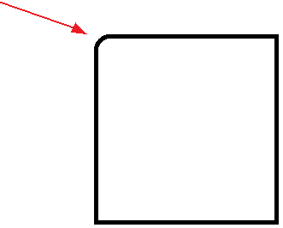
The syntax for the border-radius and box-shadow properties
border-radius: radius; /* applies to all four corners */
border-radius: topLeft topRight lowerRight lowerLeft;
box-shadow: horizontalOffset verticalOffset blurRadius
spread color;
border-top-left-radius: 50px 20px;
Notes:
To round corners, border-radius property, to add shadow, box-shadow property
There are additional features available like border-top-left-radius, and such for each corner
W3C has more information if you choose to investigate

Slide 27
The HTML for a section
<section>
<a href="ebooks_index.html">$10 Ebooks!</a>
</section>
The CSS for the section
section {
padding: 20px;
width: 160px;
border: 5px double blue;
color: blue;
font-size: 200%;
text-align: center;
font-weight: bold;
border-radius: 10px 20px 0 20px;
box-shadow: 3px 3px 4px 4px red;
}
Notes:
Border-radius properties can be assigned by each individual corner
Box-shadow properties can be positive and negative numbers, positive values offset to the right or down, and negative numbers offset to the top or left
Box-shadow first and second value are the offsets, the third value is how much blur, the fourth value how far to spread the blur, and the fifth value you should dbe able to see it the color

Slide 28

The section in a browser
Notes:
This shows the output of the previous CSS

Slide 29
The properties for setting the background color and image
background
background-color /* color name, hex or rgb… */
background-image /* url(‘image/myimage.png’) */
background-repeat
background-attachment
background-position
The syntax for the shorthand background property
background: [color] [image] [repeat] [attachment] [position];
background-repeat: [repeat] [repeat-x] [repeat-y] [no-repeat];
background-attachment: [scroll] [fixed];
Notes:
Background: color, image, repeat, attachment, and position values
background-color: color value or keyword
background-image: contain a URL, absolute or relative
background-repeat:
background-attachment:
background-position:

Slide 30
How to use the shorthand property
background: blue;
background: blue url("../images/texture.gif");
background: #808080 url("../images/header.jpg") repeat-y scroll center top;
Notes:
Here you can see how to combine multiple properties for using it shorthand.

Slide 31
How to control image repetition
background-repeat: repeat; /* repeats both directions */
background-repeat: repeat-x; /* repeats horizontally */
background-repeat: repeat-y; /* repeats vertically */
background-repeat: no-repeat; /* doesn't repeat */
How to control image position
background-position: left top; /* 0% from left, 0% from top */
background-position: center top; /* centered horizontal, 0% from top */
background-position: 90% 90%; /* 90% from left, 90% from top */
How to control image scrolling
background-attachment: scroll; /* image moves as you scroll */
background-attachment: fixed; /* image does not move as you scroll */
Accessibility guideline
Don’t use a background color or image that makes the text over it difficult to read.

Slide 32
The syntax for using a linear gradient in the background-image property
background-image:
linear-gradient(direction, color %, color %, ... );
background-image:
linear-gradient(to right, red, orange, yellow, green, blue, indigo, violet);
Notes:
The linear-gradient() CSS function creates an image consisting of a progressive transition between two or more colors along a straight line.
A good practice would be to set the background-color first, in case the browser cannot display the linear-gradient, then the element has a default color to display.
You may further investigate these properties at W3C.

Slide 33
The HTML for three divisions
<div id="eg1"></div>
<div id="eg2"></div>
<div id="eg3"></div>
The CSS for the three divisions
#eg1 {
background-image: linear-gradient(
to right, white 0%, red 100%); }
#eg2 {
background-image: linear-gradient(
45deg, red 0%, white 50%, blue 100%); }
#eg3 {
background-image: linear-gradient(
45deg, red 0%, red 33%, white 33%, white 66%, blue 66%, blue 100%); }
Notes:
The CSS for Linear-gradients displays backgrounds without images
The first parameter is direction. If a number of degrees, it should be on an angle.
To right = left to right
To bottom = top to bottom
To left = right to left
To top = bottom to top
Direction is followed by two or more parameters consisting of color and percent. The first percent indicates where the first color starts, and the last percent indicates where the last color ends. The percent in between is where the two colors meet

Slide 34
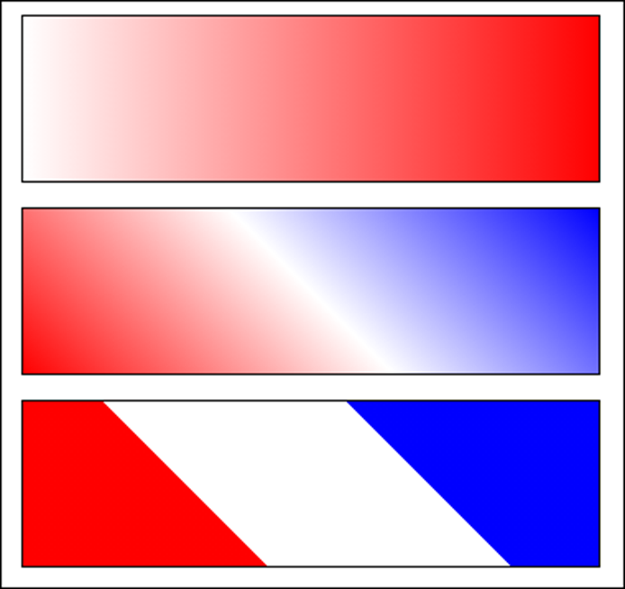
The linear gradients in a browser
Notes:
Here is a view of some different output of the linear-gradient function

Slide 35

A web page that uses borders and a gradient
Notes:
Here is that page again, but with a little more style and class, pun intended. Here they have applied borders and backgrounds. The background appears to have used the linear-gradient function “to bottom” is the direction.
You can also see the box-shadow, and border-radius applied.

Slide 36
The CSS for the gradient and borders
/* the styles that provide the background behind the body */
html {
background-image: linear-gradient(
to bottom, white 0%, #facd8a 100%);
}
body {
font-family: Verdana, Arial, Helvetica, sans-serif;
font-size: 100%;
width: 700px;
background-color: white;
margin: 15px auto;
padding: 15px 1.5em;
border: 1px solid black;
border-radius: 25px;
box-shadow: 5px 5px 0 0;
}

Slide 37
The CSS (continued)
/* the styles for the header */
header {
padding-bottom: 1em;
border-bottom: 2px solid #f2972e; }
header h2 {
...
text-shadow: 2px 2px 0 black;
/* the styles for the footer */
footer {
margin-top: 2em;
border-top: 2px solid #f2972e;
padding-top: .7em; }

Slide 38
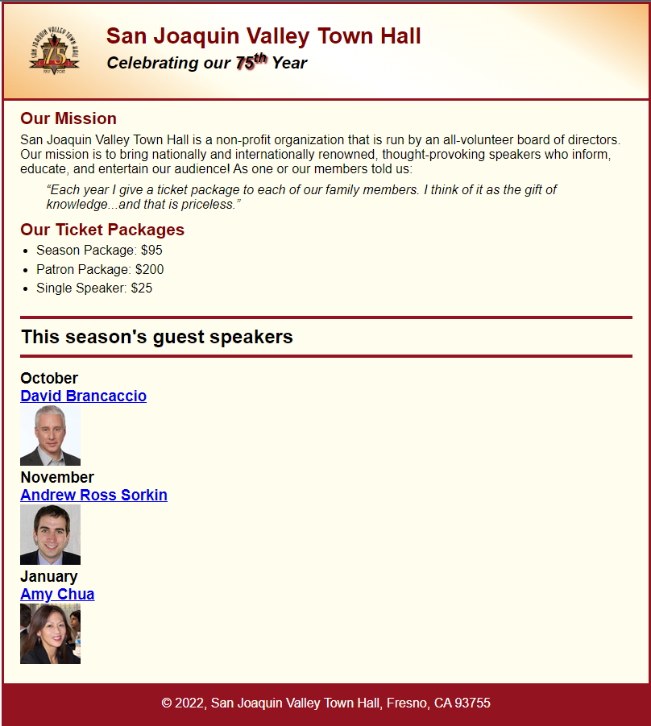
Short 5-1 Apply CSS to an HTML page
Notes:
Exercise 5.1 should like very close to this. Give it your best shot, if you need my assistance, we can work through any issues. Good luck

